Slide 1


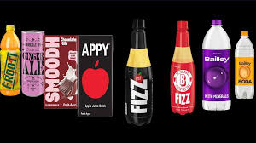
𝖯𝗋𝗂𝗏𝖺𝗍𝖾 𝖫𝗂𝗆𝗂𝗍𝖾𝖽

Slide 2

PROJECT BY
Team Leader
N.YAMINI
Team Members
M.divya
MD.mehrunisha
N.mounika
Neha kumari

Slide 3

ABOUT THE COMPANY
ᴘᴀʀʟᴇ ᴀɢʀᴏ ᴘʀɪᴠᴀᴛᴇ ʟɪᴍɪᴛᴇᴅ ɪꜱ ᴀɴ ɪɴᴅɪᴀɴ ᴄᴏᴍᴘᴀɴʏ ᴛʜᴀᴛ ᴏᴡɴꜱ ꜰʀᴏᴏᴛɪ, ᴀᴘᴘʏ, ʟᴍɴ, ʜɪᴘᴘᴏ ᴀɴᴅ ʙᴀɪʟʟᴇʏ ʙʀᴀɴᴅꜱ.

Slide 4
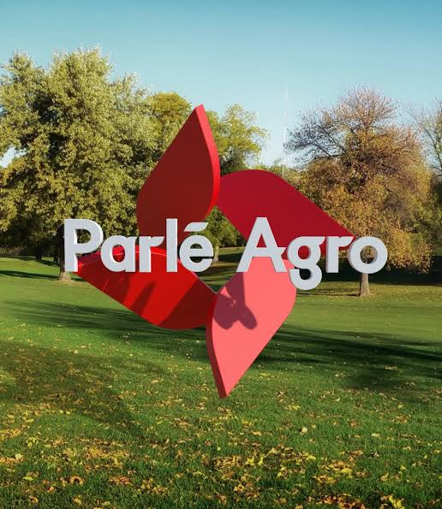
History
Parle Agro is an offshoot of Parle Products, which was founded in 1929 in British India. It was owned by the Chauhan family of Vile Parle, Mumbai. The original Parle company was split into three separate companies owned by the different factions of the original Chauhan family
Parle Products, led by Vijay, Sharad and Raj Chauhan (owner of the brands Parle-G, Melody, Mango Bite, Poppins, Kismi Toffee Bar, Monaco and Krack Jack
Parle Agro, led by Prakash Chauhan and his daughters (owner of the brands such as Frooti and Appy Fizz)
Parle Bisleri, led by Ramesh Chauhan

Slide 5
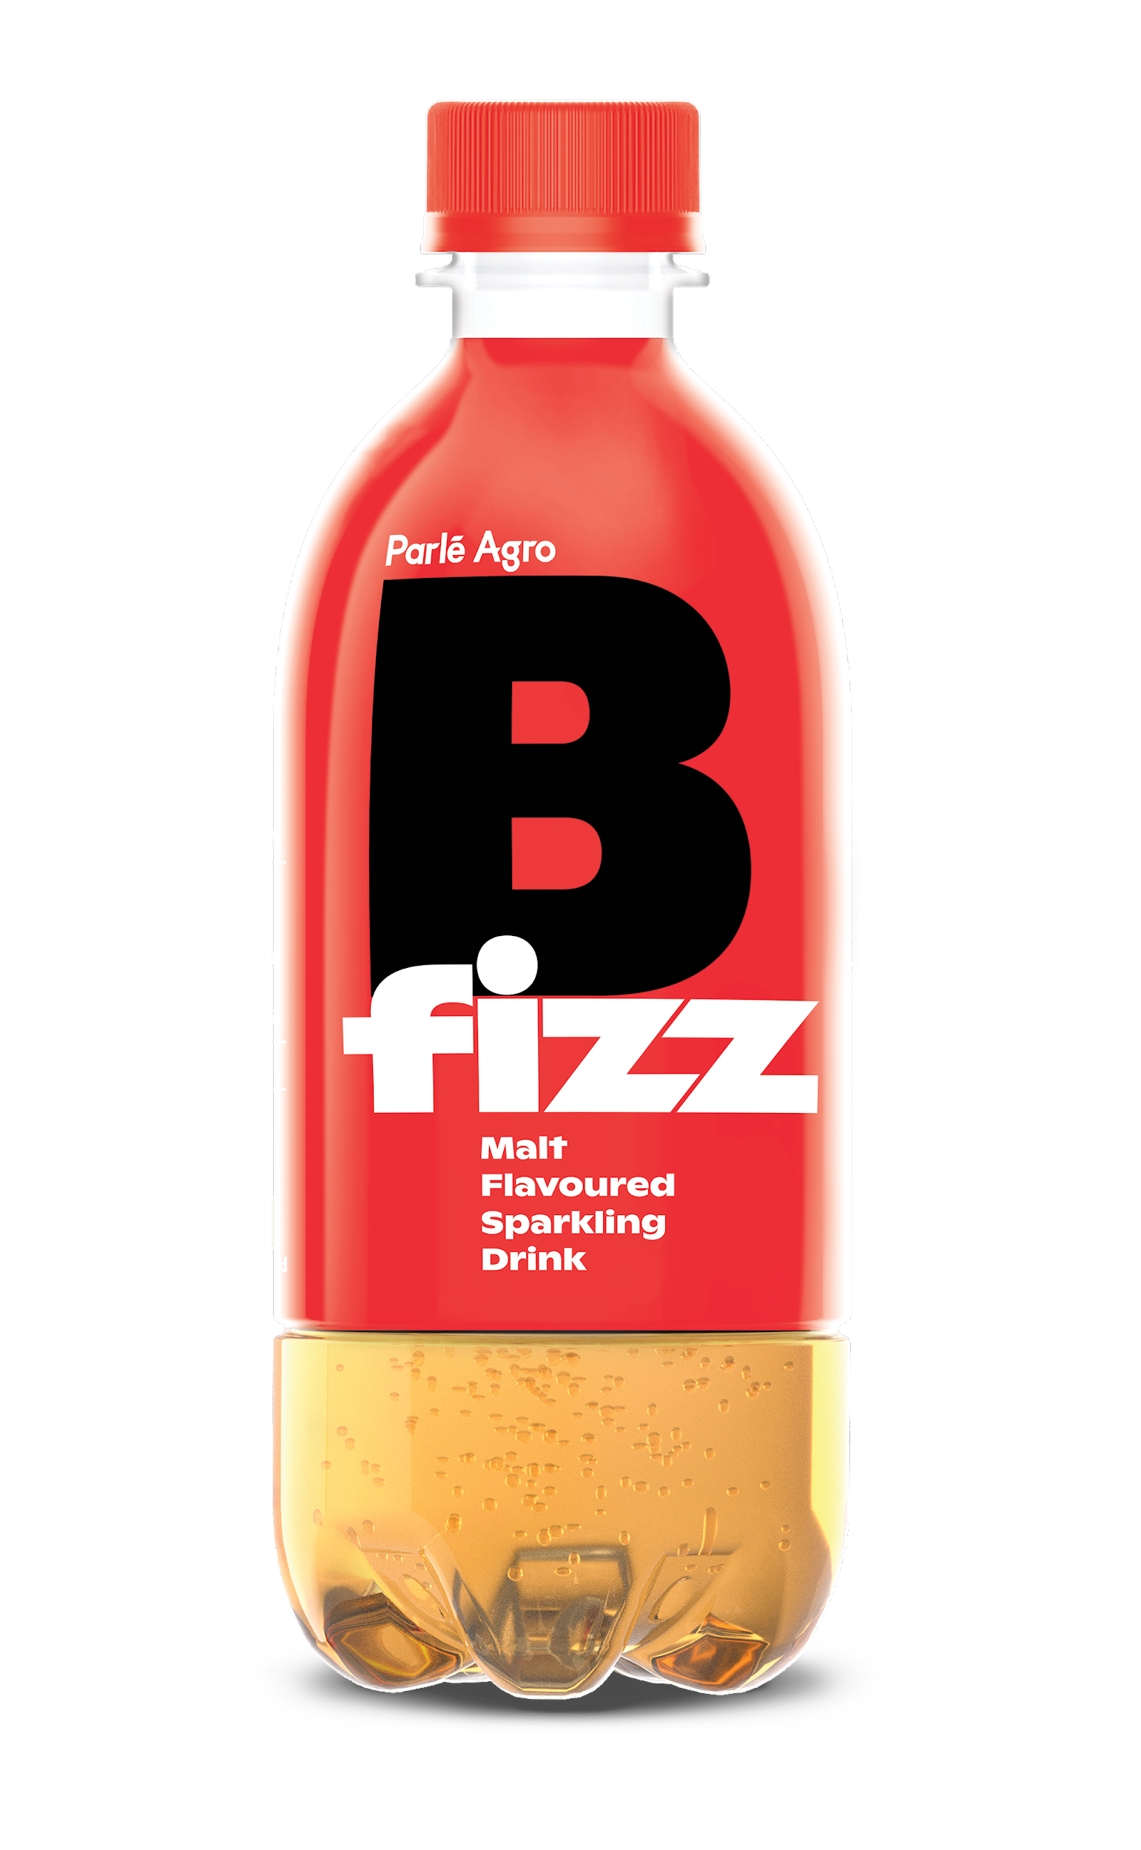
All three companies continue to use the family trademark name "Parle".
Parle Agro commenced operations in 1984. It started with beverages, and later diversified into bottled water (1993), plastic packaging (1996) and confectionery (2007). Frooti, the first product rolled out of Parle Agro in 1985, became the largest selling mango drink in India
The original Parle group was amicably segregated into three non-competing businesses. But a dispute over the use of "Parle" brand arose, when Parle Agro diversified into the confectionery business, thus becoming a competitor to Parle Products. In February 2008, Parle Products sued Parle Agro for using the brand Parle for competing confectionery products. Later, Parle Agro launched its confectionery products under a new design which did not include the Parle brand name.[4] In 2009, the Bombay High Court ruled that Parle Agro can sell its confectionery brands under the brand name Parle or Parle Confi on condition that it clearly specifies that its products belong to a separate company, which has no relationship with Parle Products.[5]

Slide 6
To be the leaders in our business
mission
MISSION
VISION
To be the leaders in our business
making Parle Agro, the No. 1 beverage company in

Slide 7
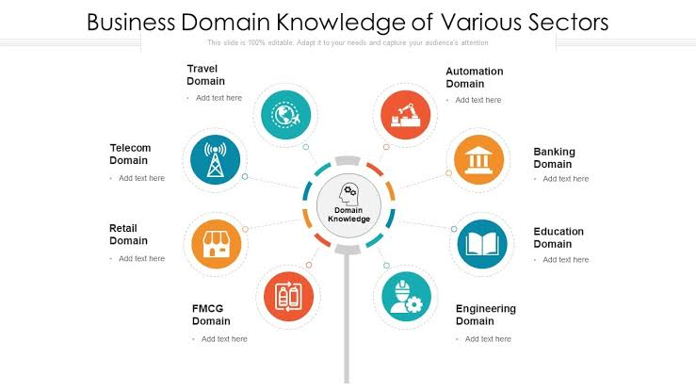
Core Value, CSR, Vision, Mission...
Marketing philosophy that reflects the needs of the Indian masses with value-for-money positioning
Parle Saraswati Vandana, one of its initiatives gives the children an opportunity to exhibit their creative skills and develop their personalities.
Vision: To be the leaders in their business domain.
Mission Maintaining high quality, introducing new and innovative products, reaching every part of India, remaining customer-centric, constantly upgrading our knowledge and skills

Slide 8

Our Values
Innovation.
Trust
There’s always room to innovate.
Build it, retain it.
Commitment.
Integrity
Commit with conviction.
Integrity connotes soundness.
Dynamic
A pace to match, would be ours.

Slide 9
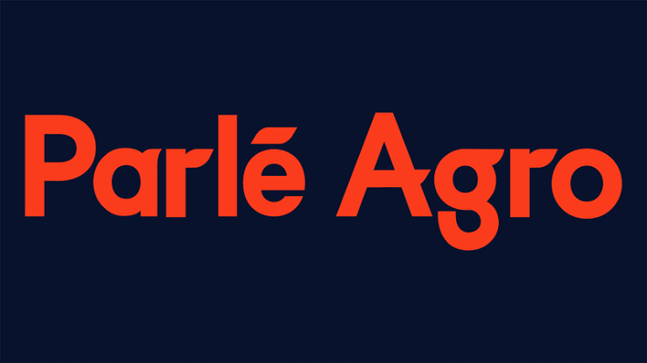
TAGLINE
This comes as Parle Agro, the maker of Frooti and Appy Fizz launched a new beverage B-Fizz in October 2020 with the tagline 'For the Bold'
Parle Agro private limited

Slide 10

Parle Agro, a pioneer in the Indian beverage industry, has been creating innovative products and iconic brands since 1985
Our bevy of brands include Frooti, Appy, Appy Fizz, BFizz, SMOODH, Bailley, Bailley Soda, Dhishoom and Frio.
Headquartered in Mumbai, with over 4000 employees, Parle Agro is the largest Indian beverage company.
Our strength lies in establishing new categories, building brands and capturing market share within those categories

Slide 11
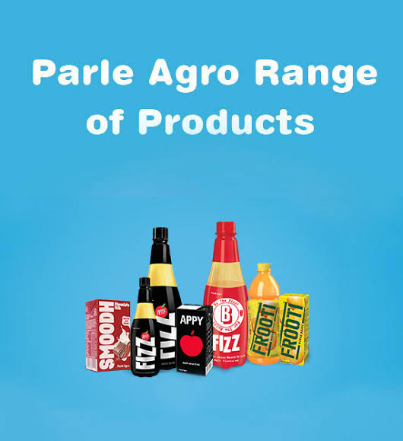
Parle Agro brands
Parle Agro Pvt. Ltd operates under three major business verticals:
Beverages – fruit drinks, nectars, juice, sparkling drinks
Parle Agro also diversified into production of PET preforms (semi-finished bottles) in 1996. Its customers include companies in the beverages, edible oil, confectionery and pharmaceutical segments.
Water – packaged drinking water
Foods – confectionery, snacks

Slide 12

Overview-Parle Agro Pvt. Ltd.
Food, Beverages Fast Moving Consumer Goods (FMCG)
Started in India in 1929. A Rs.5,000 cr. family owned business house,
• Enjoys 40% market share of the total biscuit market in India.
Owns Parle-G, which is largest selling biscuit in the world with 70% market share in the glucose biscuit category in India.
⚫ Has 12 manufacturing units for biscuits and 75 manufacturing units for confectioneries.
Parle group has a manpower strength of over 2500 employees, including over 400 professionals.

Slide 13
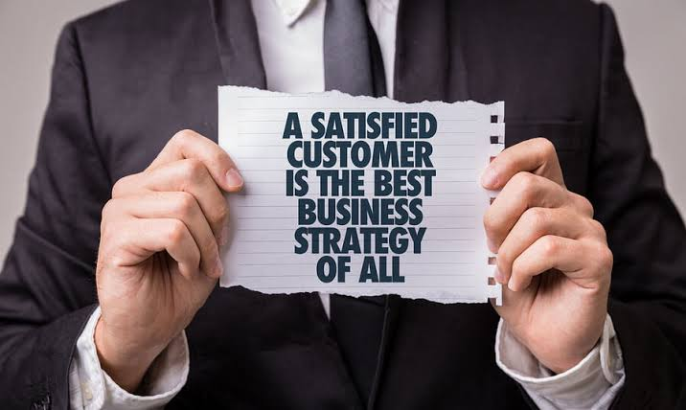
Consumer Psyche towards Parle
Parle is consumed by people of all ages, from the rich to the poor, living in cities & in villages
While some have it for breakfast, for others it is a complete wholesome meal.
For some it's the best accompaniment for chai, while for some it's a way of getting charged whenever they are low on energy

Slide 14
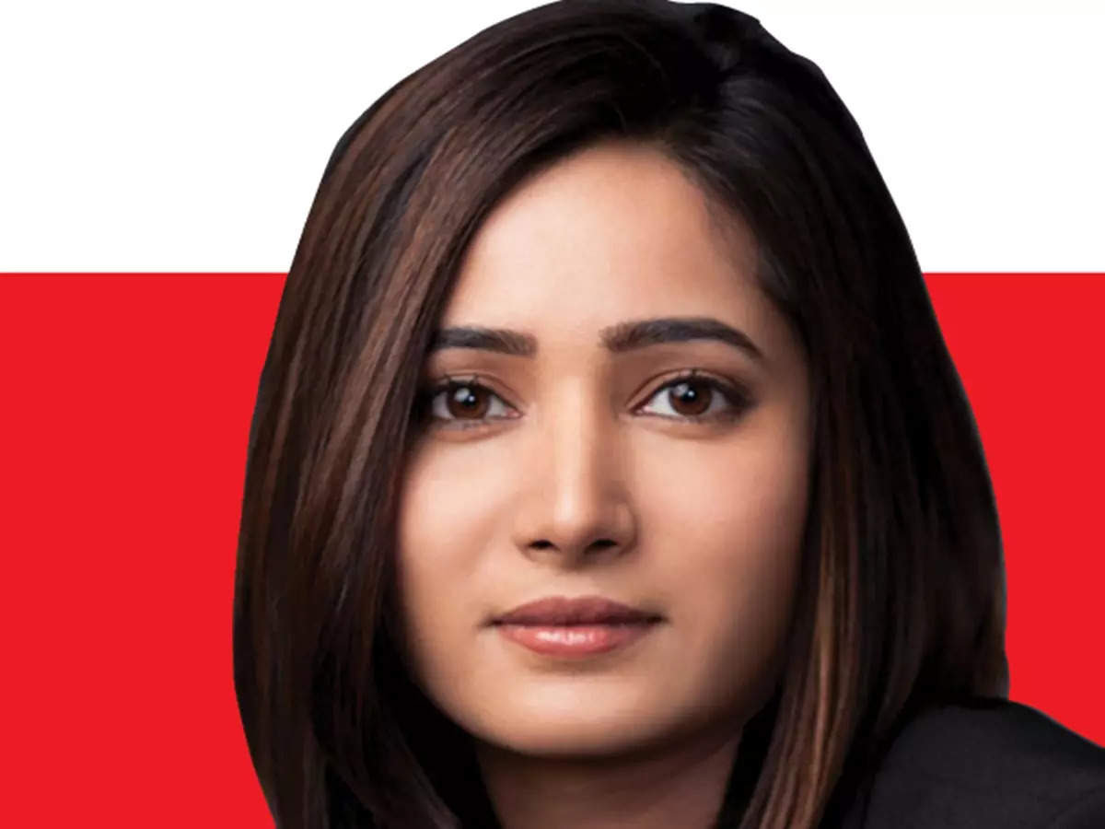
When you enter the market with a new brand, there are different ways to make a splash. One strategy is by zeroing in on attractive pricing — a sure-fire way to make the customer sit up and take notice. Recently, Parle Agro launched Smoodh, its range of flavoured milk. Its USP? It’s priced at Rs. 10 and is available in 85-ml tetra packs. Nadia Chauhan, joint MD and CMO, Parle Agro, shares the mindset behind the strategy and segues into plans for the company’s beverage portfolio. Edited excerpts:
Nadia Chauhan
Brand
Message

Slide 15
SWOT Analysis _Parle Agro
Strenghts
Weakness
Parle Brand
Diversified product range.
Ext, Distribution Network
Catering to Masses
Low & Mid Pricing Strang.
Dependence on retaliers & Stores
Dependence on parle_G
Brand product.
Opportunities
Threats
Estimated Annual growth of 20%
Changing consumer prefernence
Increasing Demand for Sugar
Hike in cost of raw material affecting cost of production. Increasing distribution cost. Competitive Local bakery products
Enty of various new entrant ITC etc.

Slide 16
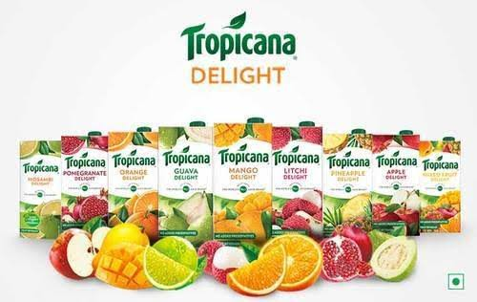
competitors
Usp:-Tropicana is one of the leading brands in the food & beverages sector. Tropicana SWOT analysis evaluates the brand by its strengths & weaknesses which are the internal factors along with opportunities & threats which are the external factors.
https://www.tropicana.com/

Slide 17
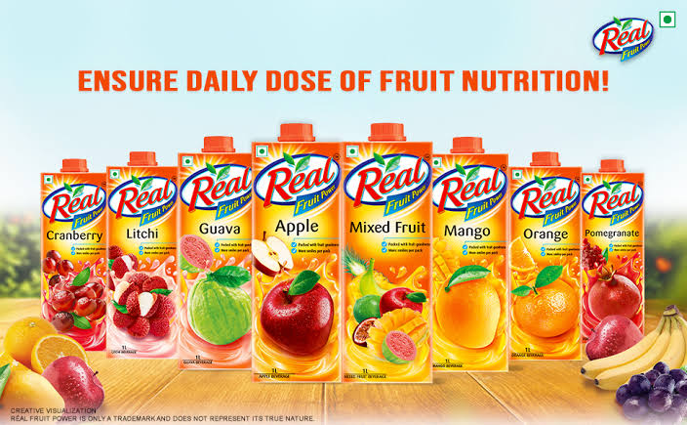
Usp:- Dabur Real Juice is one of the leading brands in the food & beverages sector. Dabur Real Juice SWOT analysis evaluates the brand by its strengths & weaknesses which are the internal factors along with opportunities & threats which are the external factors.
https://www.dabur real juice.com/

Slide 18
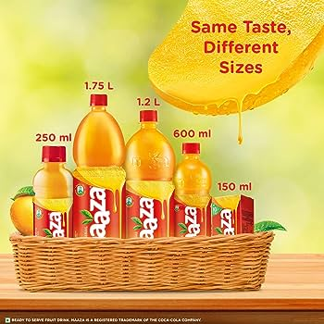
Mazaa USP:- Maaza is one of the leading brands in the food & beverages sector. Maaza SWOT analysis evaluates the brand by its strengths & weaknesses which are the internal factors along with opportunities & threats which are the external factors.
https://www.maaza.com/

Slide 19

Marketing Strategy
Promotion Strategy
Rural-urban penetration of Biscuit:
Urban Market: 75% to 85%
Rural Market: 50% to 65%
Per capita consumption of Biscuits:
-INDIA 18kg
South East Asian Countries 2.5 kg to 5.5 kg
-USA 75
Advertising it was advertised mainly through press ads.
Communication spoke about the basic benefits of energy and nutrition
In 1989 Parle G released its "Dadaj" commercial which was a huge success and was aired over a period of 6 years. The communication spoke about the basic benefits of energy and nutrition.
The next level of communication associated the brand with the positive values of life ke honesty, sharing and caring. Eg: hindustan kitakat
Parehas started the use of celebrity in their advertisements

Slide 20

Basies Of Future Strategic Plan
Great Brand Experience
Clear And Consistent Positioning
Sense Of Dynamism
Sense Of Authenticity
Strong Corporate Culture

Slide 21
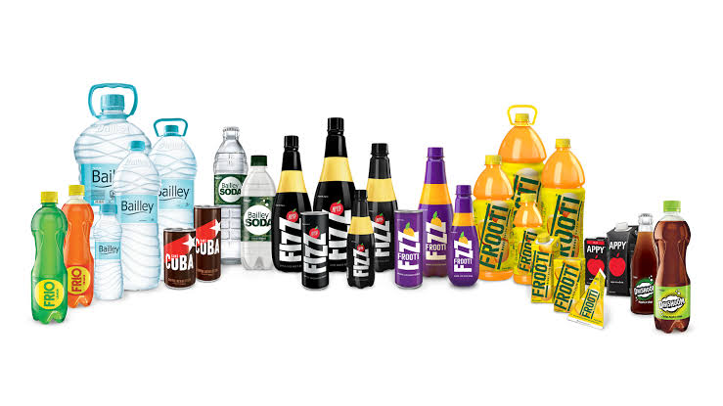
Packaging
• Always Innovative In Packaging
• In India First Company To Introduce Tetra Packs
They Initially Introduces Pet Bottles, Also They Are The First In India
2003 They introduces Triangle Pack For Penetration Price

Slide 22
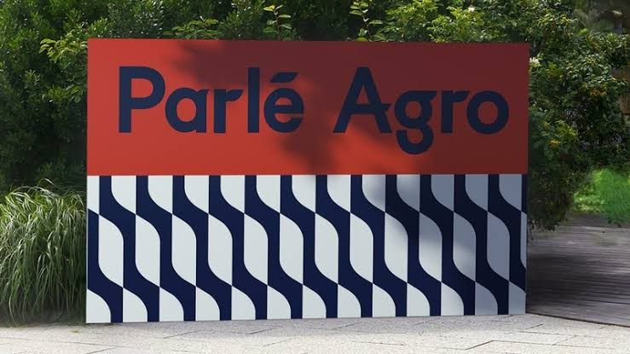
Brand Awareness
When you enter the market with a new brand, there are different ways to make a splash. One strategy is by zeroing in on attractive pricing — a sure-fire way to make the customer sit up and take notice. Recently, Parle Agro launched Smoodh, its range of flavoured milk. Its USP? It’s priced at Rs. 10 and is available in 85-ml tetra packs. Nadia Chauhan, joint MD and CMO, Parle Agro, shares the mindset behind the strategy and segues into plans for the company’s beverage portfolio. Edited excerpts

Slide 23

In the world of digital marketing service, lead generation company can serve as your first step to get closer to the customer, based on the interest or inquiry of the products/services shown by them
Leads generation, being the first step in bringing customers to the company, is why it is paid great attention. The team helps in generating leads for the company to get more customers and the CRM team will convert those leads into customers. The campaigns used for generating leads are conceptualised by our team who implements them to gain validated leads. The qualified leads are then delivered to the clients or their marketing/sales manager through emails.
Lead Generation

Slide 24

Conclusion
Parle Agro is one of the very few FMCG food companies in India whose entire gamut of products are having a USP of upholding the "Pink Health" of the consumer. However most of the modern trade consumers feel that this message is not clearly communicated by Parle Agro
•A good number of modern trade consumers are brand conscious. Maximum of their purchases inside the store (FMCG in particular) are based on their brand recall value. During the project tenure, it was good to observe Parle Agro's recall value on a positive rank. But somewhere we are lacking in encashing the opportunity by not mentioning company logo on Hippo & Hippo Round Round.
Most of the modern trade stores have their own web-space where they offer the convenience of shopping from home or office. We can increase our presence on their web-space. Although this measure wont increase our revenues significantly, but it will

Slide 25

Thank you

